Slide 1
LAKBAY - A THREE DIMENSIONAL GAME ABOUT DRIVING FUNDAMENTALS AND ROAD COURTESY AND SAFETY OF BACOOR MUNICIPALITY
By:
Hannie May G. Defacto
John Paul R. Consuelo
Nommel Isanar L. Amolat
Bachelor of Science in Information Technology 3-2

Slide 2
General Rules (Gameplay Constraints)
Two phases: Linear Play and Free-Roam Play.
Answer all the questions per level correctly as much as you can.
Levels must be completed chronologically before succeeding to the next one.
Complete and pass the Linear Play to unlock the Free-Roam.
In Linear Play, incoming vehicles must be dodged by steering in a lane where no incoming vehicles are present, otherwise the player will lose a life after three consecutive collisions from the incoming vehicles.
Complete the Missions in Free-Roam to finish the game.
In Linear Play, you begin with 3 lives, 3 hints, and 25 coins but as you go along you can gain coins by answering questions correctly.
The Coins you earned can be used to buy Fuel in the game.
Fuel is what drives the vehicle.

Slide 3


Essentials
Essentials are assets that will help the player throughout the Linear Play. The default number of Essentials the player can possess are 25 coins, 3 hints, 3 lives, and 100 fuel.
Coins
Can be obtained by answering questions correctly.
Hints
Can be used to remove two wrong choices on a question.
Life
The number of times the player will respawn once the gas runs out. Life is also reducible once the player is hit by incoming vehicles three times consecutively.
Fuel
Fuel is what drives the player's vehicle, once it runs out game ends unless the player has remaining lives. Fuel can be refilled using the coins earned in the gameplay.
The default Fuel bar at the beginning of the game is fully filled. Once the player is dead, the player will respawn with a half-filled Fuel tank.

Slide 4
Modes
There are two game modes in the game. Each mode runs through the two phases of the game. The only difference between the two is the number of questions.
Non-Professional Mode
This mode consists 40 questions
Professional Mode
This mode consists 60 questions

Slide 5
Phases
Phases are the points in the game that the player must play in each of the said two modes. There are two phases in the game that the players must complete in order to finish the overall game play.
Linear Play
The phase of the game wherein the player must answer a set of questions and pass the passing score to unlock the Free-Roam Play. The player must avoid the arriving vehicles and successfully reach each question checkpoints. It is composed of three levels. The number of questions per level varies depending on the level.
This phase is composed of three levels:
City Road
Provincial Road
National Road

Slide 6
Phases
Free-Roam Play
This is the phase of the game wherein, the player must complete 10 missions. The player can roam around the map to do each mission. The missions are categorized into five and every category has its subtopics.
Backing and Turning
Turning right and left in an intersection.
Backing inside or outside of the street.
Road Crossing and Light Traffic
Road crossing.
Driving at light traffic.
Maneuvering
The "Y" turn and about maneuvering style.
Garage Driving
Outside the garage
Into the garage using the backing procedure.
Parking
Entering/leaving angle parking space.
Perpendicular Parking
Parallel Parking.

Slide 7
Backing And Turning
Turning right and left in an intersection
Backing in/ outside of street
Road crossing
Driving at Light traffic
The "Y" turn and about maneuvering style.
Outside the garage
Into the garage using backing procedure.
Entering/leaving angle parking space
Perpendicular parking
Parallel parking
Road Crossing And Traffic
MISSIONS
Maneuvering
Garage Driving
Parking
Figure 1: Free-Roam Play Diagram

Slide 8
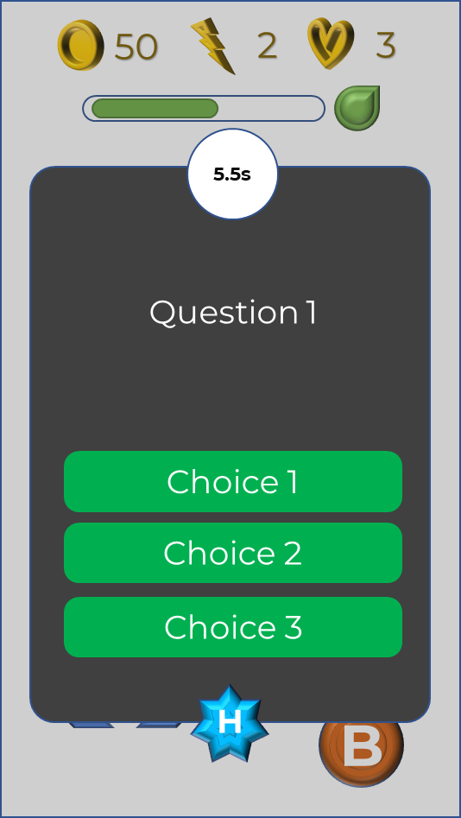
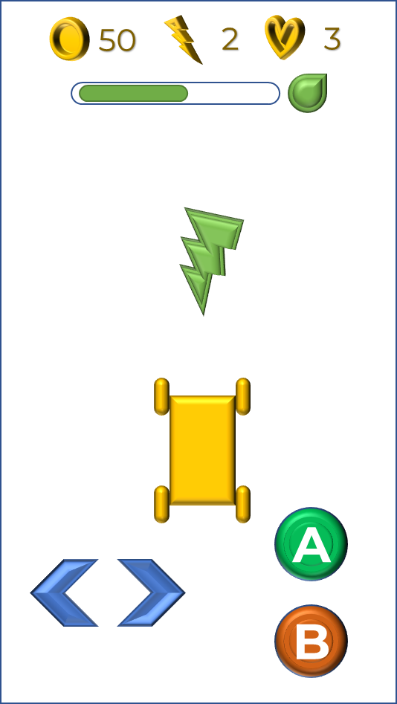
Timer
Correct Answers
Coins Earned
Lives
Fuel Bar
Refill Button
Choices
Question
Vehicle
Left Button
Accelerate
Hint
Right Button
Break
Figure 2: Linear Play Diagram

Slide 9
Mission
Player/Vehicle
Minimap
Figure 3: Free-Roam Play Diagram

Slide 10
Phase Goals
Clear each level and reach the passing score on your chosen mode for Linear Play.
Clear each level and reach the passing score with your chosen mode for Linear Play.
Reaching the passing score of the Linear Play will unlock the Free-Roam Play.
MODES | PASSING SCORE | No. Of Items
Non- Professional | 30 | 40
Professional | 45 | 60
Table 1: Passing Scores per Mode for Linear Play

Slide 11
Phases’ Goals
For Linear Play, as you progress each level, questions begin to increase and becomes more difficult to answer.
The mode that the user has chosen will have a different total number of questions.

Slide 12
MODES
NON -PROFESSIONAL
PROFESSIONAL
Level 1: City Road
(10 questions)
Easy
Level 1: City Road
(15 questions)
Level 2: Provincial Road
(15 questions)
Moderate
Level 2: Provincial Road
(20 questions)
Level 3: National Road
(15 questions)
Difficult
Level 3: City Road
(25 questions)
Figure 4: Linear-Play’s levels Diagram

